Slide 1
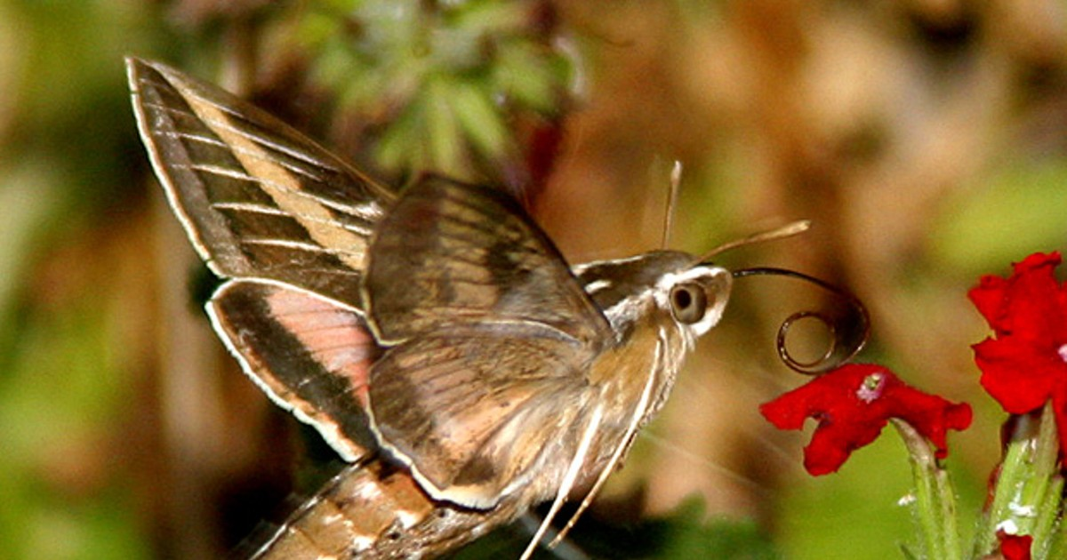
Partitioning Diversity

Slide 2
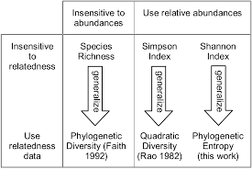


Diversity Indices
Species richness
Shannon-Wiener
Simpson’s
(Allen et al 2009)
Notes:
Earlier in chapter 10 we saw 3 different diversity indices: Species richness, R, the count of the number of species in a sample or area; the most widely used measure of biodiversity Shannons Simpson’s diversity. This index is (i) the probability that two individuals drawn from a community at random will be different species Unequal contributions: Richness depends most heavily on rare species, Simpson’s depends most heavily on common species, and Shannon-Wiener stands somewhere between the two

Slide 3
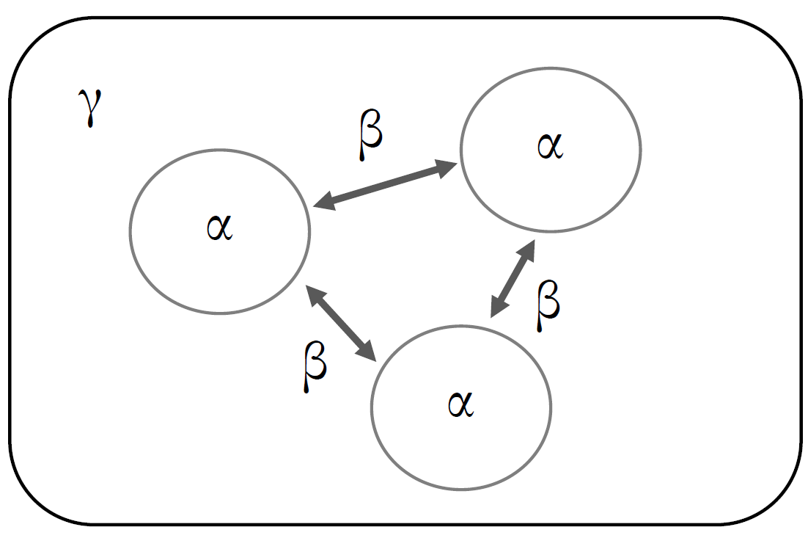


Levels of Diversity and Scaling
What type of diversity measurement?
How does beta link scales?
Additive
Multiplicative
Number and size of alpha samples?
Interpretation?
Gamma diversity across entire region
Beta Diversity between sites
Alpha diversity within a sample/site
Daly et al. 2018
Notes:
There are many proponents of different ways to measure beta diversity (just like diversity indexes), but they can have drastically different statistical implications. There’s no perfect measure as all lead to a loss of information/reduction of dimensions, and diversity partioning will give an average difference among subcommunites but may not reflect what’s really happening in any given sample.
Differences in interpretation of B
Ba and Bm change at different rates, also dependent on sample size

Slide 4
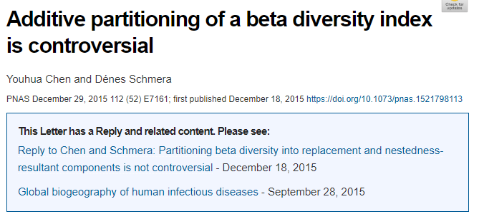
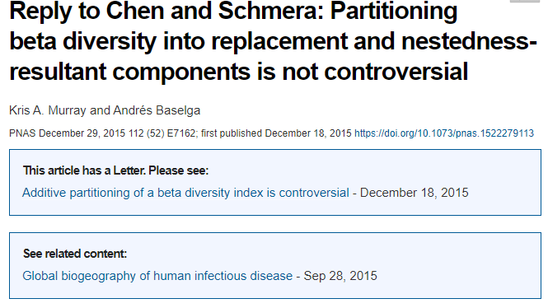


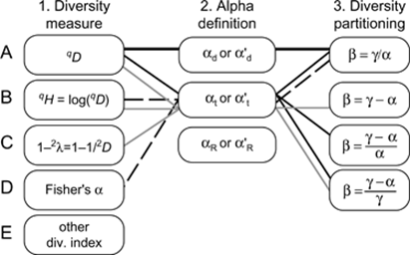
Strong Opinions and Many Methods
“Replacement” camp
“Nestedness” camp

Slide 5
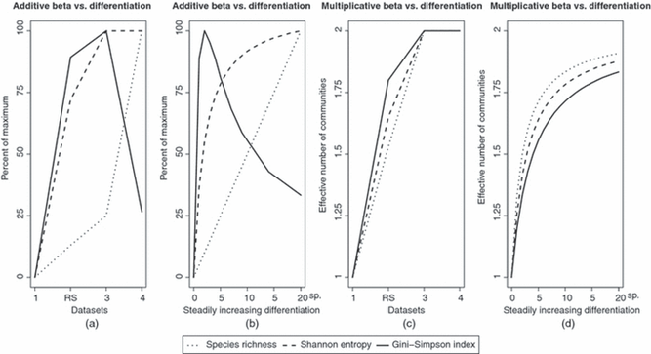
Additive vs Multiplicative Example
Notes:
Artificial datasets with increasing differences between mock communities to test what partitioning methods might be better to predict what subcommunities need the most conservation efforts. The type of diversity index can vary how well the partitoning method reflects the amount of actual differences. A,B are normalized b/c units are different among indices. Any index that drops in value as differences increase, failed to predict the differences in the communities and is bad for conservation.

Slide 6
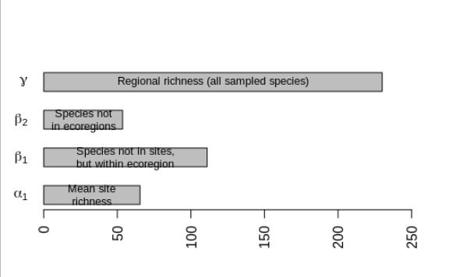
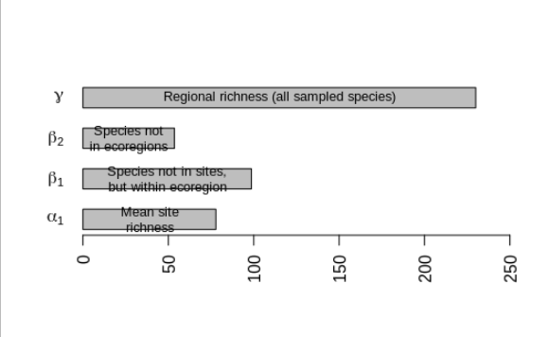
Partitioning Diversity Example
a1 b1 a2 b2 g
65.42857 111.00000 176.42857 53.57143 230.00000
a1 b1 a2 b2 g
77.80952 98.61905 176.42857 53.57143 230.00000

Slide 7
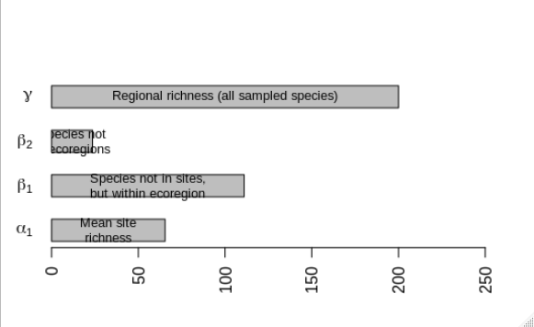
Partitioning Diversity Example
a1 b1 a2 b2 g
65.42857 111.00000 176.42857 53.57143 230.00000
a1 b1 a2 b2 g
65.42857 111.00000 176.42857 23.57143 200.00000

Slide 8
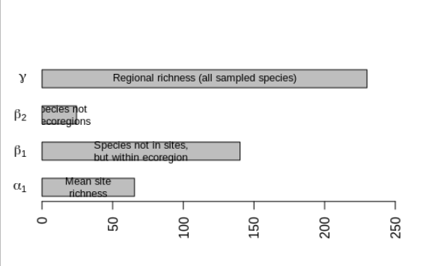
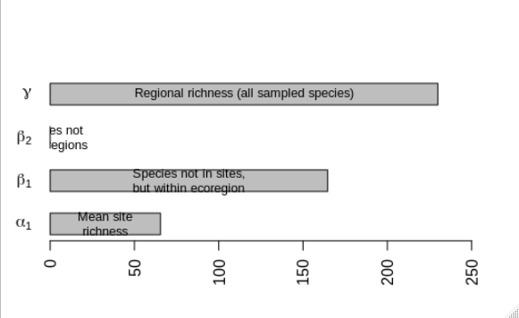
Partitioning Diversity Example
NCT=230, WAP=173
NCT=230, WAP=230
a1 b1 a2 b2 g
65.42857 140.14286 205.57143 24.42857 230.00000
a1 b1 a2 b2 g
65.42857 164.57143 230.00000 0.00000 230.00000

Slide 9
References
Daly AJ, Baetens JM, Baets B De. 2018. Ecological Diversity : Measuring the Unmeasurable. doi:10.3390/math6070119.
Tuomisto H. 2010. A diversity of beta diversities : straightening up a concept gone awry . Part 1 . Defining beta diversity as a function of alpha and gamma diversity. doi:10.1111/j.1600-0587.2009.05880.x.
Additive partitioning of a beta diversity index is controversial. 2015. 112:7161. doi:10.1073/pnas.1521798113.
Reply to Chen and Schmera : Partitioning beta diversity into replacement and nestedness- resultant components is not controversial. 2015. 112:7162. doi:10.1073/pnas.1522279113.
Schmera D, Podani J. 2011. Comments on separating components of beta diversity. Community Ecol. 12:153–160. doi:10.1556/ComEc.12.2011.2.2.
Baselga A. 2010. Partitioning the turnover and nestedness components of beta diversity. :134–143. doi:10.1111/j.1466-8238.2009.00490.x.
Chao A, Ricotta C. 2010. analyses. :65–76. doi:10.1111/j.1472-4642.2009.00626.x.

